Slide 1


Mitch Ball
27-March-2023

Slide 2
Outline
Executive Summary
Introduction
Methodology
Results
Conclusion
Appendix

Slide 3
Executive Summary
Launch Costs may be predicted by collecting data, cleaning data, exploring correlations, and generating these predictions using machine learning.

Slide 4
Introduction
SpaceX is an aerospace manufacturer who was first to successfully launch and land vertically-reusable rocket boosters. By enabling the reuse and speedy recovery of rocket boosters, launch costs are greatly reduced by not needing to manufacture a new booster for each launch.

Slide 5
Business Problem
A substantial amount of the launch cost is directly fixed to rocket booster materials and technology
By reusing rocket boosters, per launch costs are reduced, enabling SpaceX to remain the least expensive deliverer of space expeditions
Future Launch costs can be determined by predicting the failure (success) rates per launch
How does SpaceX determine which rockets will land successfully and what factors will come into play to determine/predict a successful landing

Slide 6

Section 1

Slide 7
Methodology: (General Overview)
Data collection methodology:
By importing SpaceX launch data using an API and Web scraping
Data Wrangling Overview:
For missing values (Payload Mass, used the avg)
Converted outcomes (Sea, etc.) A successful land where it was planned. (True or False)
Exploratory data analysis (EDA) using visualization and SQL
Discovered new patterns in the data
Interactive visual analytics using Folium and Plotly Dash
Dash and folium were used to achieve this goal
Predictive analysis using classification models
Machine learning attempts were made to make predications

Slide 8
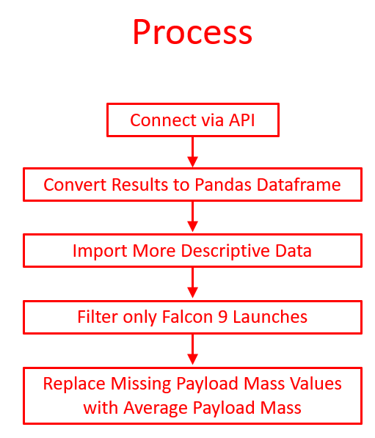
Data Collection Method (API): (Used SpaceX API)
Link for complete details/results (Github)...

Slide 9
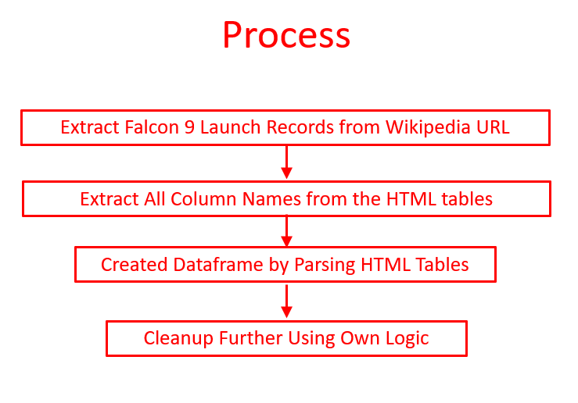
Data Collection Method (Scrape): (Used Web Scraping)
Link for complete details/results (Github)...

Slide 10
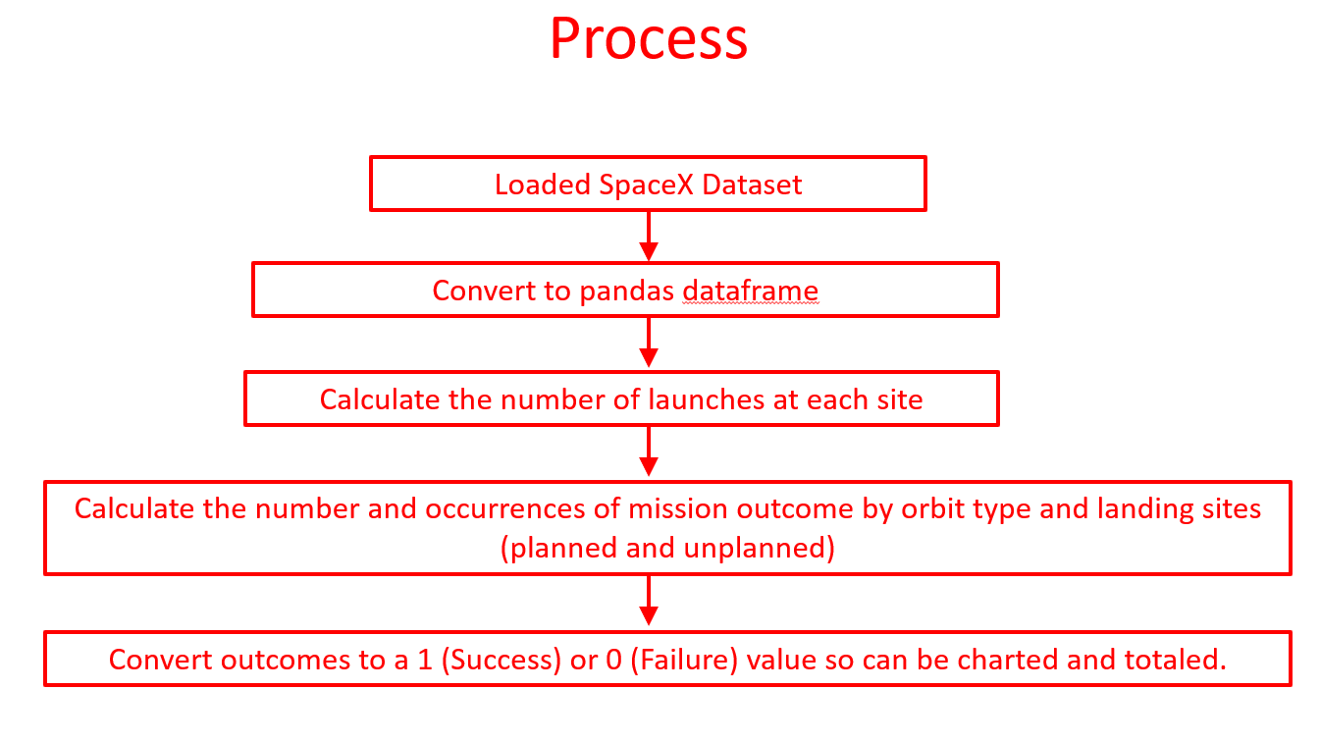
Data Wrangling (Used Pandas and Numpy)
Link for complete details/results (Github)...

Slide 11
Exploratory Data Analysis (Used Pandas and Matplotlib)
Visualizations were created to find correlations with Successful Outcomes
Flights vs Payload Mass
Flights vs Launch Site
Launch Site vs Payload Mass,
Payload vs Orbit Type
Annual Trend by Year.
Link for complete details/results (Github)...

Slide 12
Exploratory Data Analysis: (with SQL Methods)
The key Falcon 9 query results are…..
Launch Sites: 5
Average Payload Mass for the Falcon 9: 2,534 kg
Successful Outcomes Ratio: 100/101 = 99%
Link for complete details/results (Github)...

Slide 13
Interactive Analysis: Launch Sites (with Folium)
An Interactive Map is Available for:
Launch Site Locations…..(Map Circles)
Launch Site Successes and Failures…..(Map Marker Clusters)
Launch Sites Distances to highways, railways, populated areas…..(Map Lines)
Link for map details/results (Github)...

Slide 14
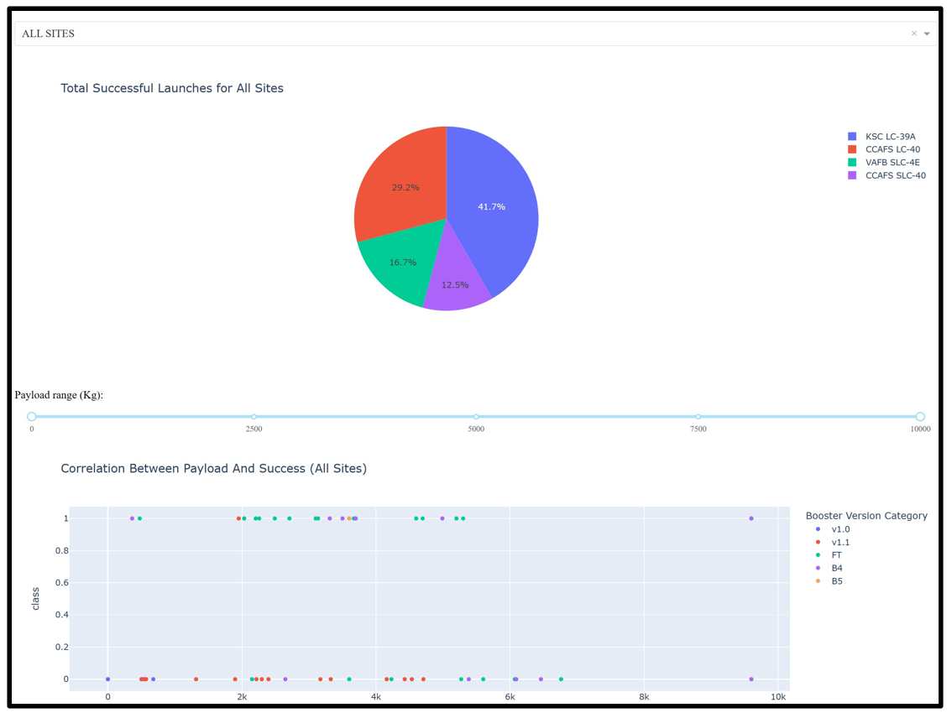
Interactive Analysis: Success & Failures Dashboard (with Plotly Dash)
Discovering Sites with Most Successful Launches and Launch Rates…..(Pie Chart)
Determining the Correlation Between Payloads and Successes…..(Scatter Chart)
Link for code details (Github)...

Slide 15
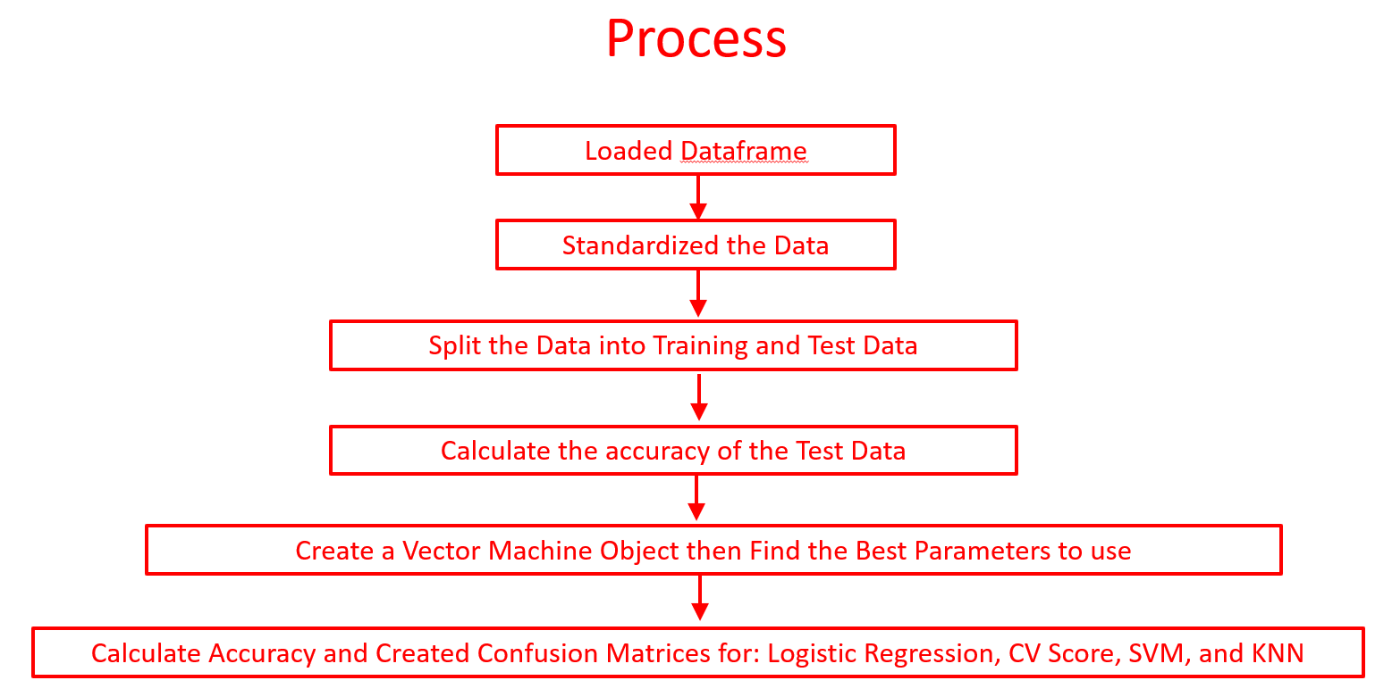
Predictive Analysis (with Matplotlib, Seaborn, scikit-learn)
Link for code details (Github)...

Slide 16

Section 2

Slide 17
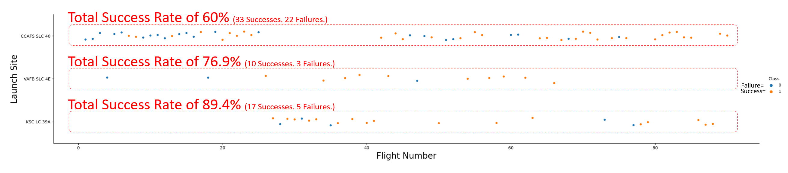
Insights:
Success Rates…Flights vs. Launch Site (Using Scatterplot)
Success rates by Launch Site. KSC LC 39A is far ahead of the others. Independent of Launch Site, successes become more prevalent over time.

Slide 18
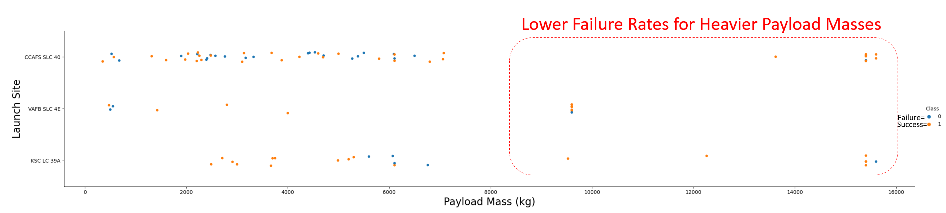
Insights:
Success Rates…Payload vs. Launch Site (Using Scatterplot)
There are lower failure rates for heavier payloads, independent of Launch site

Slide 19
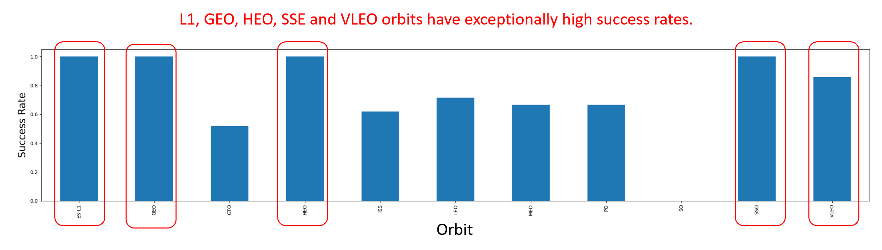
Insights:
Success Rates…By Orbit Types (Using Bar Graphs by Percentage)

Slide 20
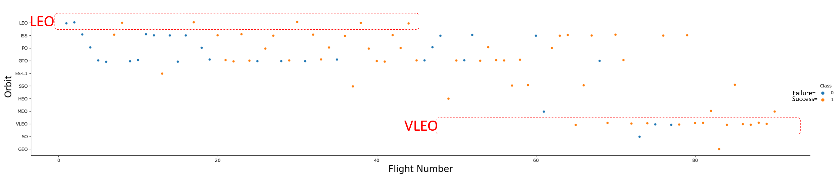
Insights:
Success Rates…By Orbit Type Over Time (Using Scatterplot)
Other than LEO and VLEO (orbits), there isn’t any substantial correlation of successes based on the number of flights.

Slide 21
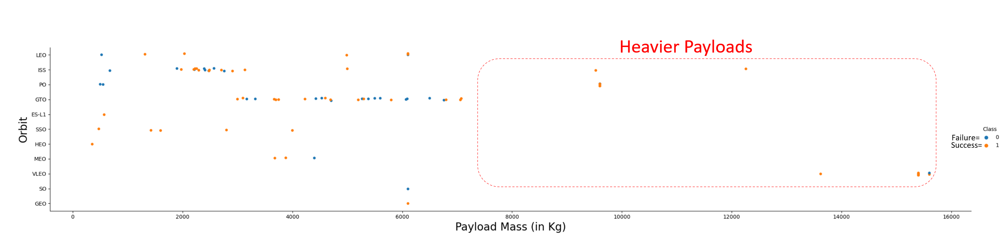
Insights:
Success Rates…Payload vs. Orbit Type (Using Scatterplot)
Though heavier payloads have a higher percentage of successes, there isn’t enough data to conclude that at this time. More data is needed.

Slide 22
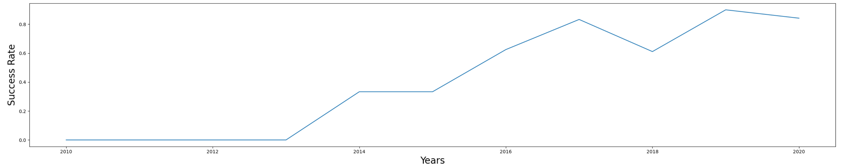
Insights:
Launch Successes…Yearly Trend (Using Line Graph)
Since 2013, the overall launch successes keep increasing.

Slide 23
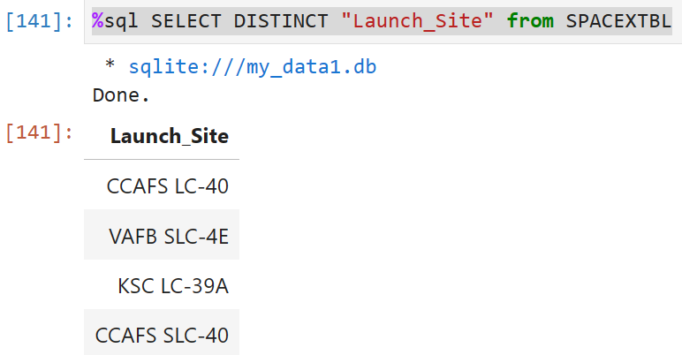
Insights:
Launch Site Names (Using SQL)
CCAFS LC-40 (Cape Canaveral: Launch Complex 40)
VAFB SLC-4E (Vandenberg: Space Launch Complex 4E)
KSC LC-39A (Kennedy Space Center: Launch Complex Pad 39A)
CCAFS SLC-40 (Cape Canaveral: Space Launch Complex 40)

Slide 24
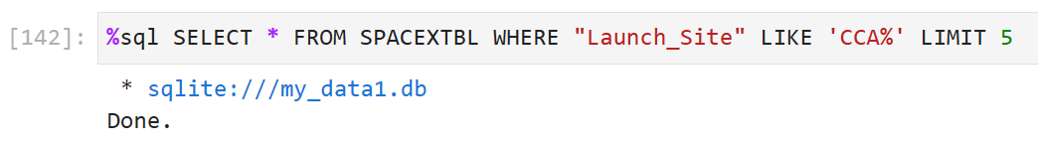
Insights:
Some CCA Launch Record Examples? (Using SQL)
Below is an example of 5 launch records where the site begin with `CCA`

Slide 25
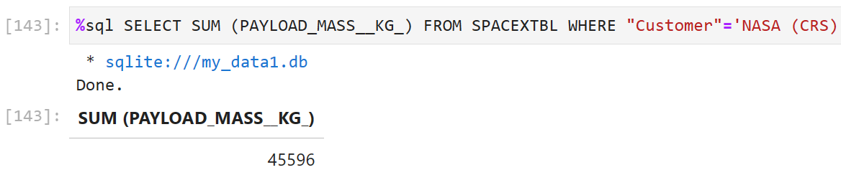
Insights:
The Total Payload Mass (Using SQL)
45,596kg is the total payload mass carried by boosters from NASA (CRS)

Slide 26
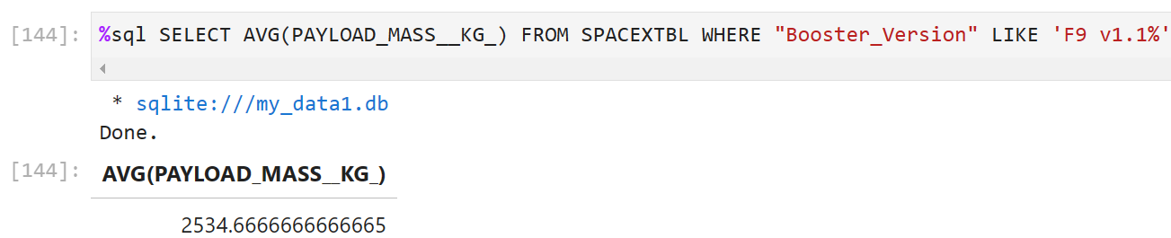
Insights:
The Average Payload Mass by F9 v1.1 (Using SQL)
2,534.66 kg is the average payload mass carried by booster version F9 v1.1

Slide 27
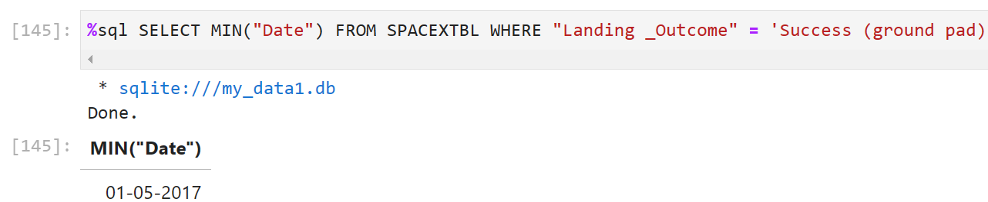
Insights:
First Successful Ground Landing Date (Using SQL)
01-05-2017 was the first successful landing outcome on a ground pad

Slide 28
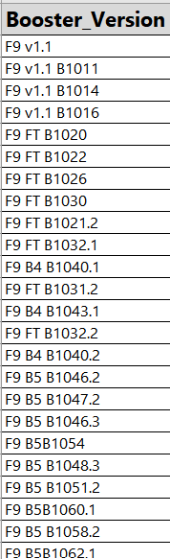
Insights:
Boosters Successfully Landing on Drone Ships with 4K-6K payloads (Using SQL)

Slide 29
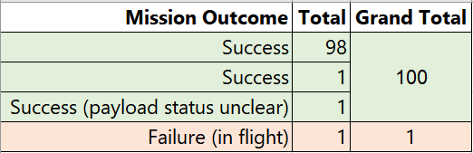
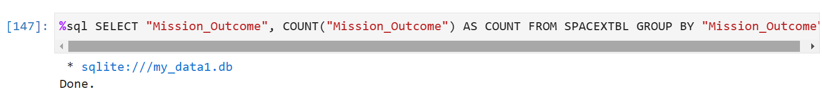
Insights:
Total Number of Successful and Failure Mission Outcomes (Using SQL)

Slide 30
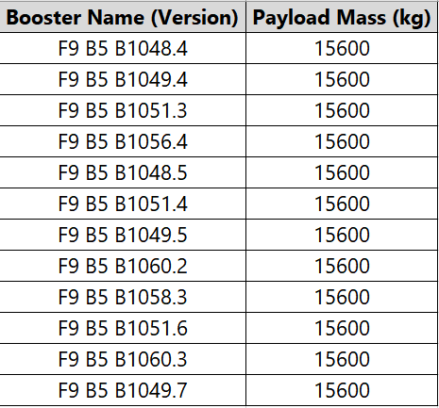
Insights:
The Boosters that carried the Maximum Payloads (Using SQL)

Slide 31
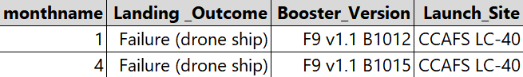
Insights:
Failed Landing Outcomes for 2015 (Using SQL)

Slide 32
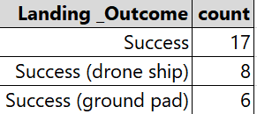
Insights:
Landing Outcomes between 2010-06-04 and 2017-03-20 (Using SQL)

Slide 33

Section 3

Slide 34
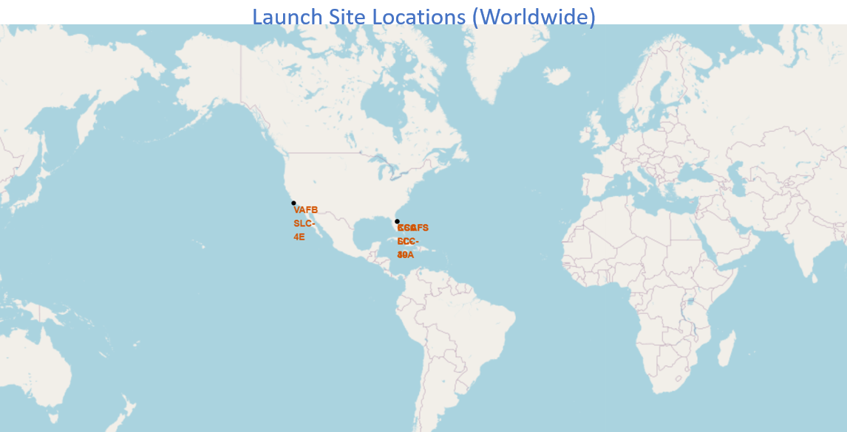
Visual Analysis
Launch Site Locations (with Folium)
All of the Launch sites are located on the coasts.

Slide 35
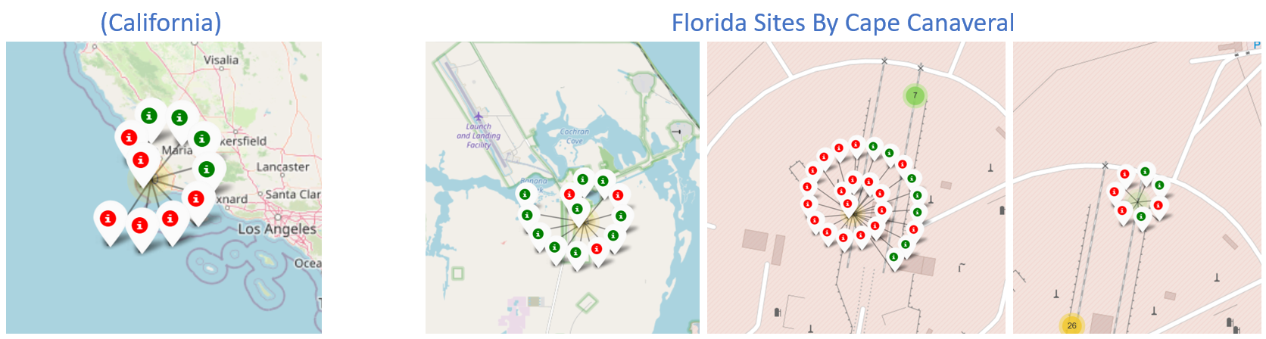
Visual Analysis
Launch Outcomes (with Folium)
Per-site launch outcomes success percentages varied (Green=Success, Red=Failure)

Slide 36
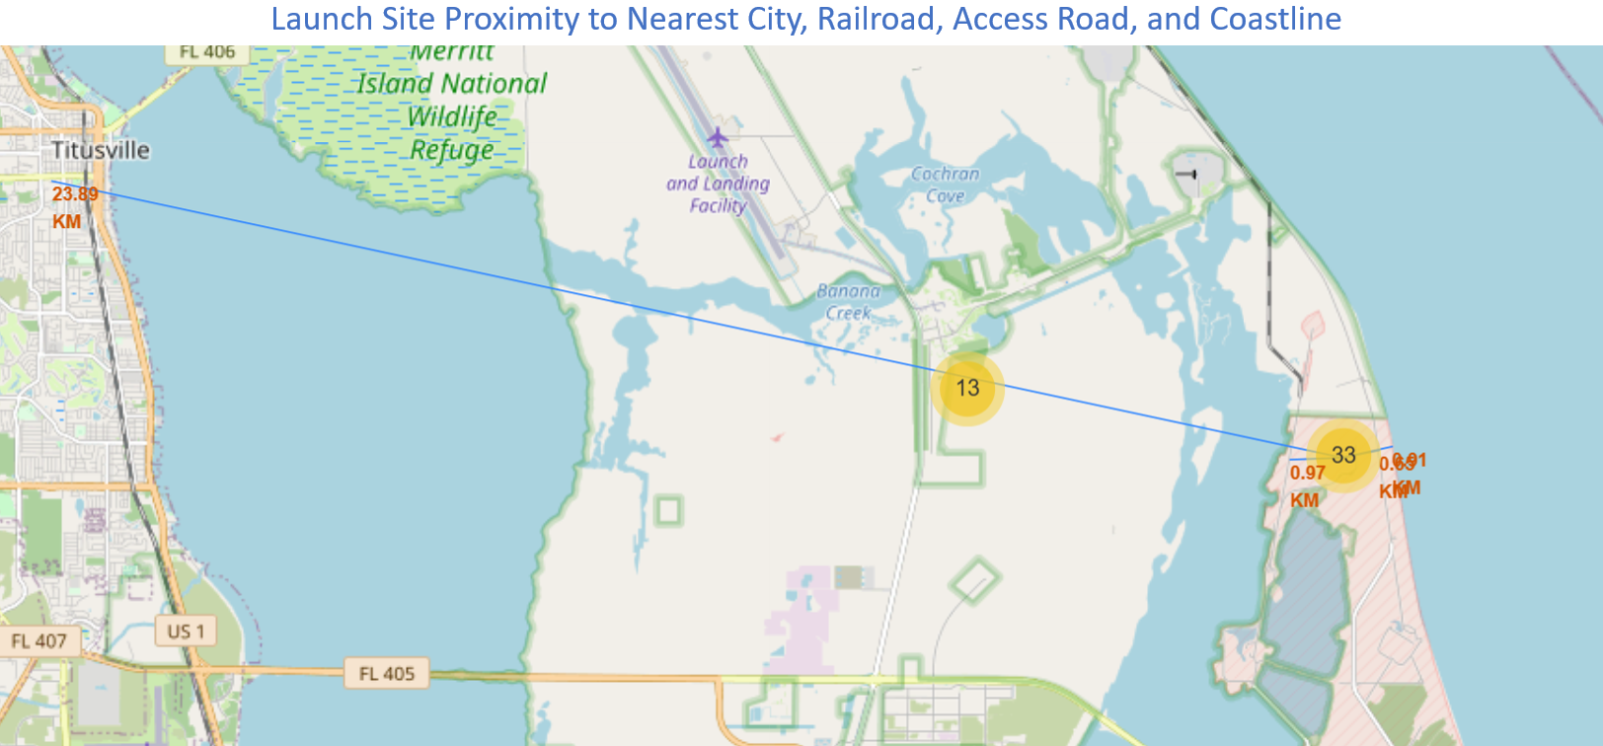
Visual Analysis
Launch Site Proximity Analysis (with Folium)
Launch sites minimize risk and maximize operation efficiencies by being close to transportation and water, while being away from people. For example, for one launch site, the nearest city is 23.89km, railroad is 97 km, road is 65km, and ocean is 91km.

Slide 37

Section 4

Slide 38
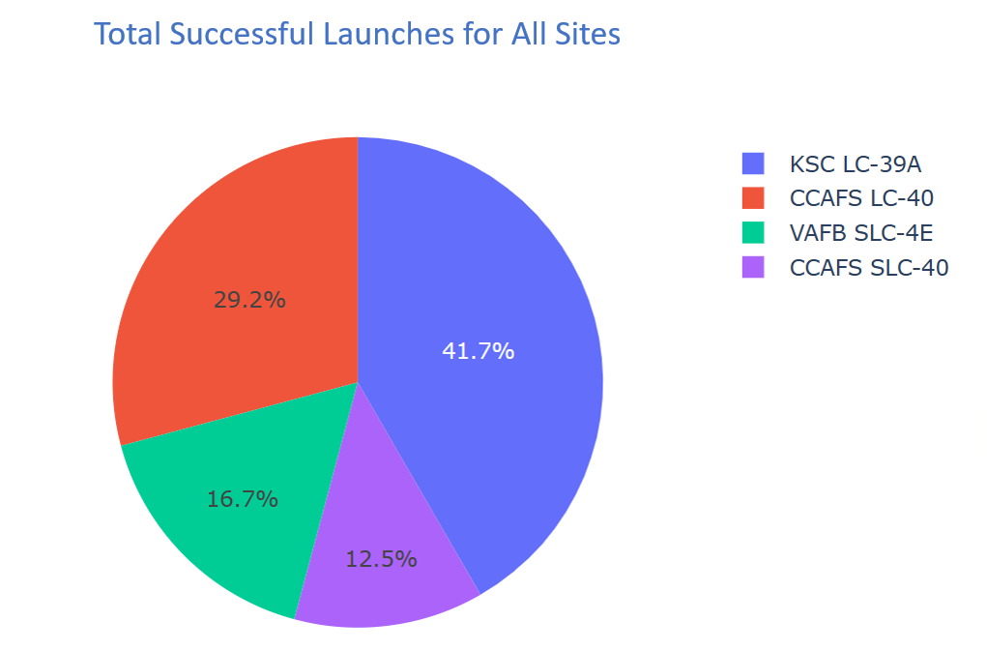
Visual Analysis
Successful Launch Composition by Site (with Plotly Dash)
Launch Complex 39A (Kennedy Space Center) has produced the most successful launches.

Slide 39
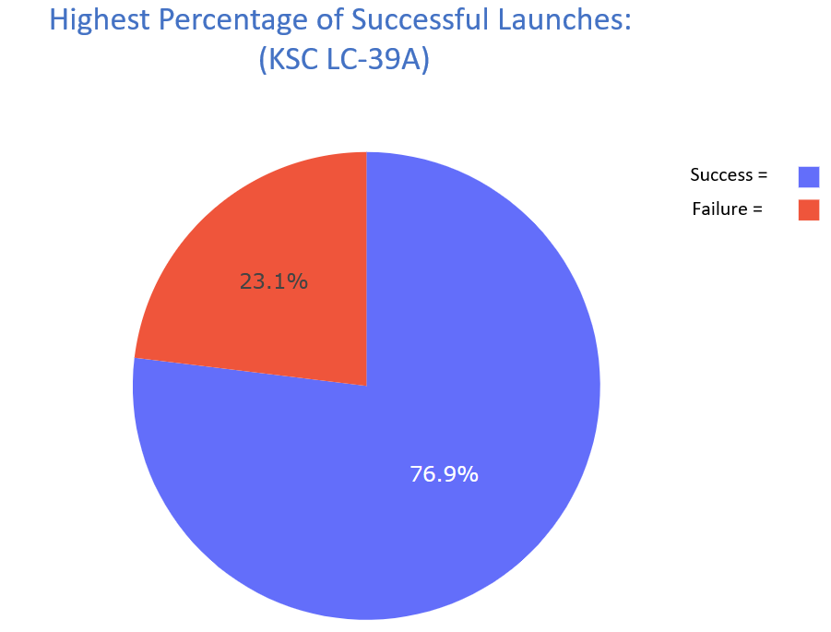
Visual Analysis
Launch Sites with the Highest % of Successful Launches (with Plotly Dash)
Launch Complex 39A (Kennedy Space Center) produced the highest percent of successful launches.

Slide 40
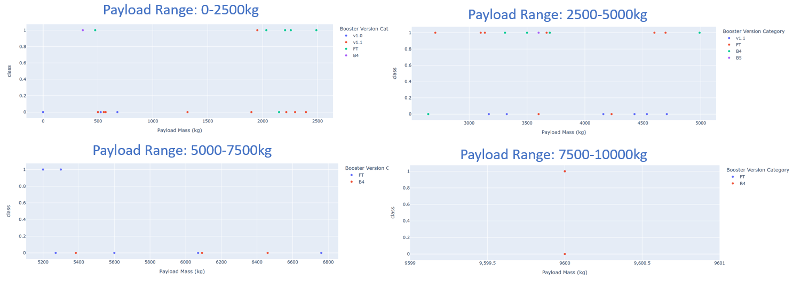
Visual Analysis
All Launch Sites: Payload vs Outcome (with Plotly Dash)
The most successful launch outcomes occur with payloads between 2.5K-5K (55% success rate). The most successful boosters used are the FTs (65.2%). Note: The B5 was excluded from these results due to it only being used once with a single success (100%).

Slide 41

Section 5

Slide 42
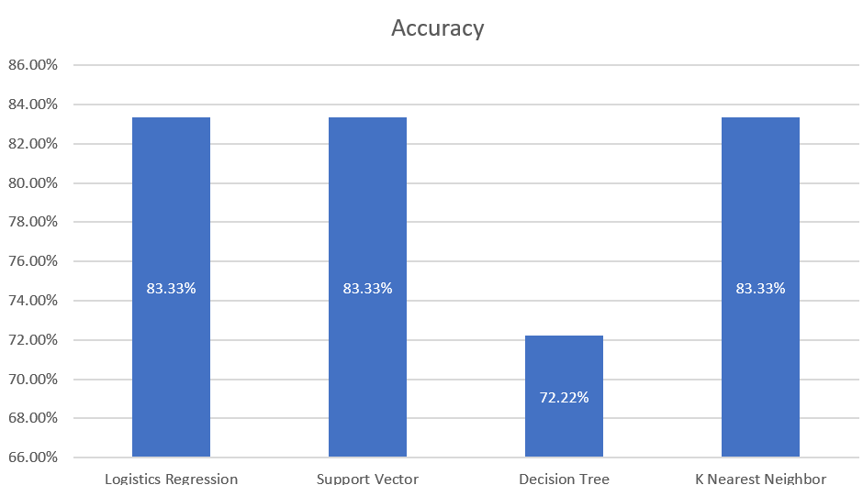
Classification Accuracy
Determining best model accuracy rate
Initially, there are 3 potential methods to use, all at 83.3%.
The confusion matrix may add more information to better determine which model should be used.

Slide 43
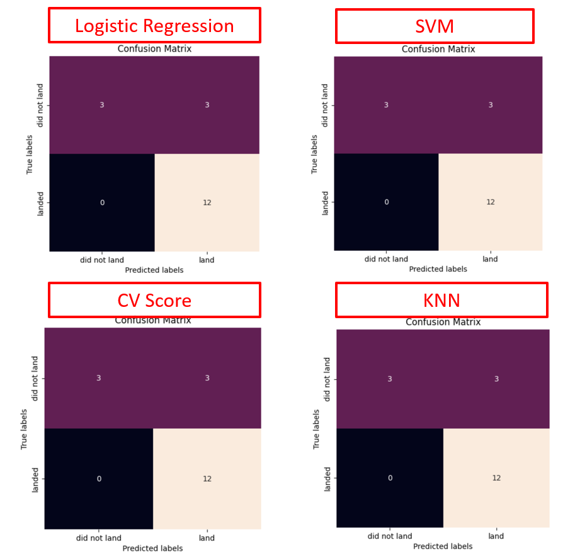
Classification Accuracy
Confusion Matrix: Determining the best performing model…
Based on the calculations, the best performing model cannot be determined.
(All of the confusion matrixes are identical)

Slide 44
Conclusions
The Falcon 9 Launch Boosters are the most reliable
Kennedy Space Center (39A) is the most successful
Payloads between 2,599kg and 5,000kg yield the most successful outcomes

Slide 45
Appendix
Click here to view any or all supporting files on Github

Slide 46


